Slide 1
Iterative parameter calibration of hardening laws using inverse fitting by Bayesian optimization
Vedant Zope
Advisors: Xuan Binh, Li Zinan, Rongfei Juan
Supervisor: Junhe Lian
Department of Mechanical Engineering
Aalto University

Slide 2
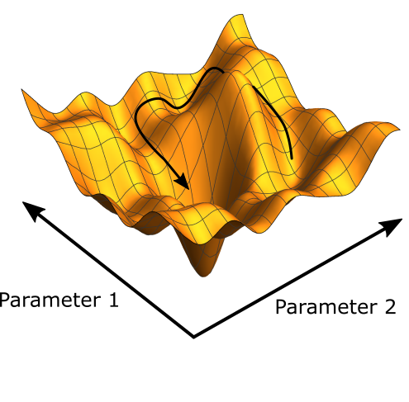
Table of contents
Progress of completed tasks
Workflow, target FD curves
Parametric studies
Smoothing filter, initial simulation guesses
Loss function definition
Bayesian Optimization configurations
Iteration results
Loss of iterations
Conclusion

Slide 3
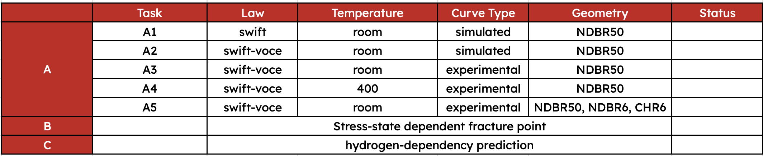
Progress of completed tasks
✓
✓
✓
✓
Ongoing
To be done
To be done

Slide 4
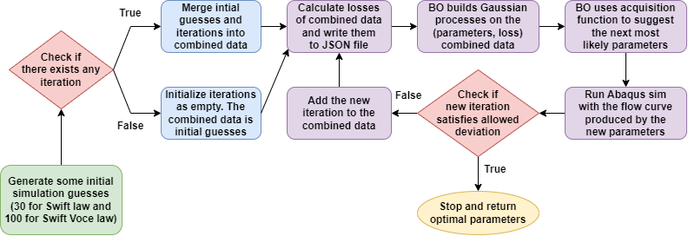
Project workflow (single objective optimization Task A1-A4)
This workflow is designed to take into account 3 aspects
The workflow can be interrupted and restarted at the last iteration when the code was interrupted
No reliance on the ML surrogate model
Utilize iterative optimization such as Bayesian Optimization
Iterative parameter calibration loop

Slide 5
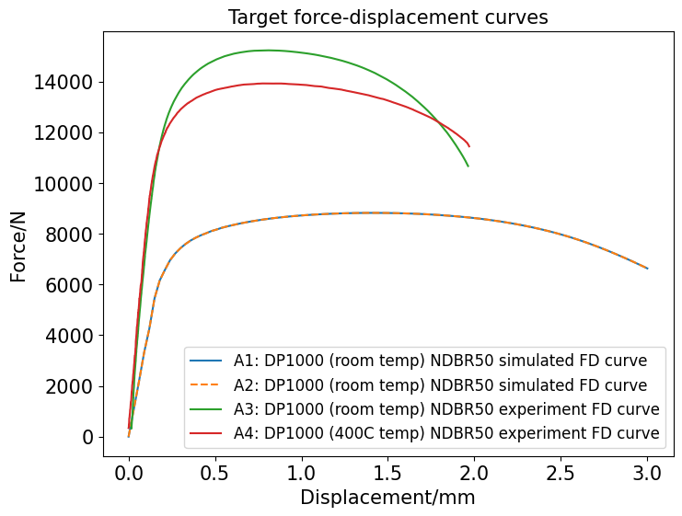
Target force-displacement curves for Task A1-A4
DP1000
NDBR50 geometry
different temperatures
two different flow curves
A1 | Swift law | Same target curves: simulated curves known parameters
A2 | Swift-Voce law
Slope difference:
Due to the discrepancy between experimental and simulated geometry (thickness).
Both tasks’ parameters should produce the same flow curve using two different hardening laws

Slide 6
Swift – Voce equation
Swift law(3 parameters)
σ(swift) = K * (ε + ε_0) ^ n
Definition used:
σ(swift) = c2 * (ε + c3) ^ c4
σ is the stress
ε is the strain
K = c2 is the strength coefficient
ε_0 = c3 is a small strain offset used to ensure that the law is applicable at very small strains
N = c4 is the strain-hardening exponent
Voce Law(3 parameters)
σ(Voce) = σ_0 + (σ_i - σ_0) * (1 - exp(-b * ε))
Definition used :
σ(voce) = c5+ c6* (1 - exp(-c7 * ε))
σ is the stress
ε is the strain
σ_0 = c5 is the initial yield stress
σ_I = σ_0 + c6 is the saturation stress (the maximum stress the material can achieve)
b = c7 is a parameter that controls the rate of work hardening
Combined Swift – Voce Law (7 parameters)
σ(swift-voce) = c1 *σ(swift) + (1-c1)*σ(voce)
σ(swift-voce) = c1*c2*(ε + c3) ^ c4 + (1-c1)*c5+ c6* (1 - exp(-c7 * ε))
c1 weight parameter – balances the weight between swift and voce law

Slide 7
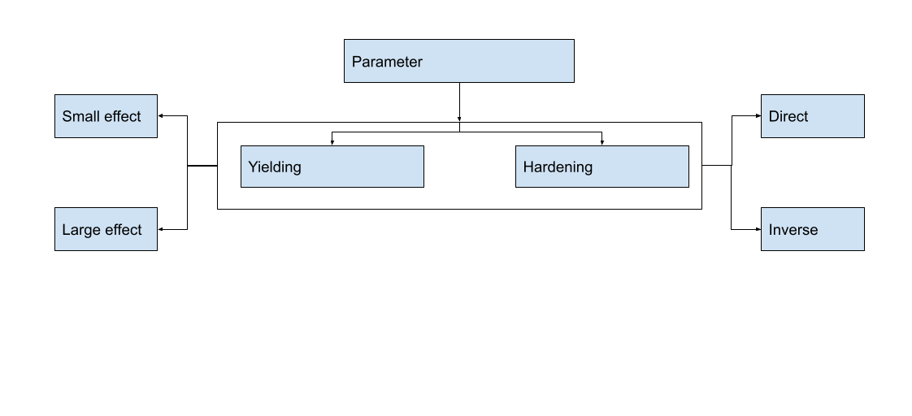
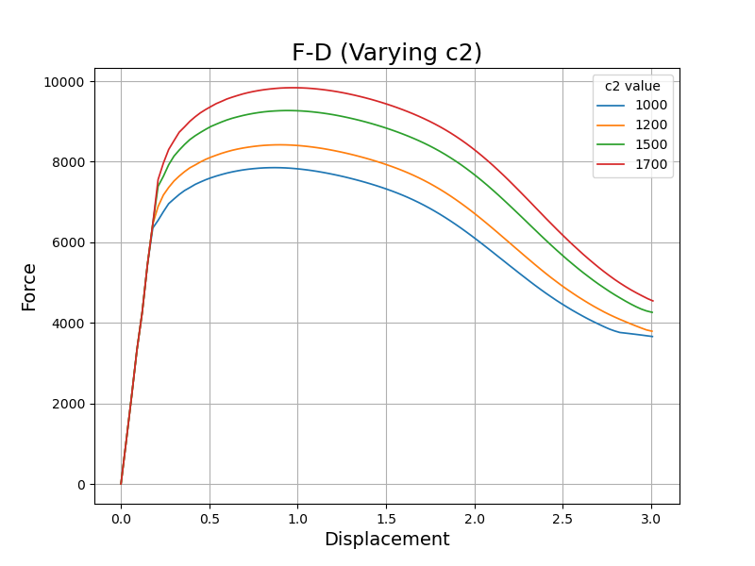
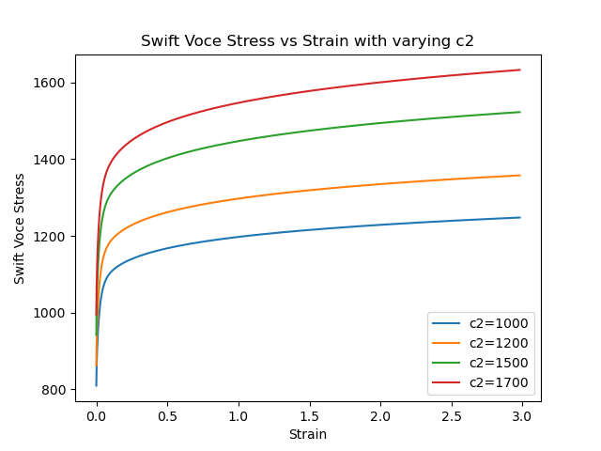
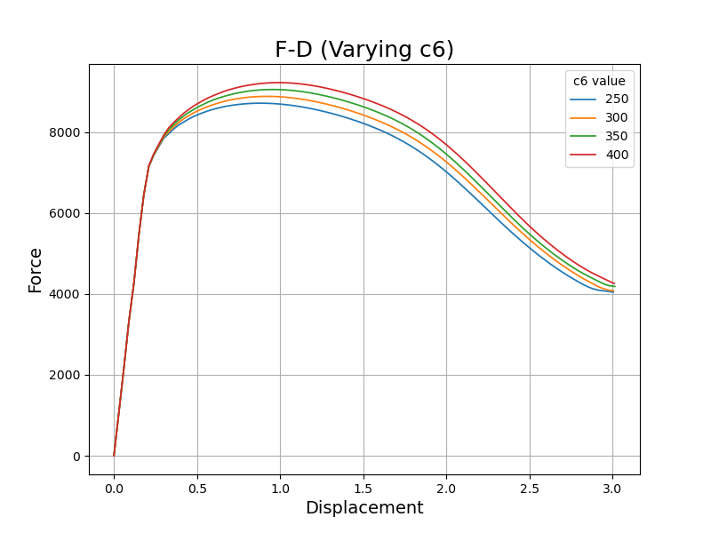
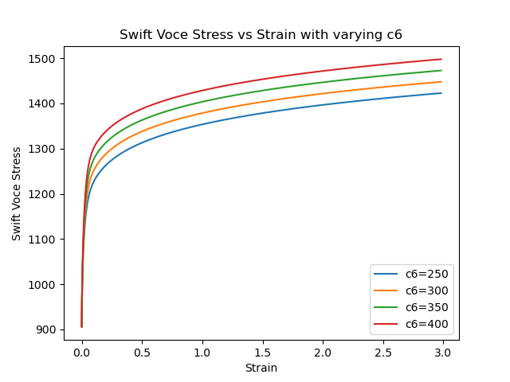
Parametric studies of Swift Voce hardening law
→ Main aims of parametric studies:
• Parameter range
(physical upper and lower bound)
• Parameter type (yielding / hardening)
• Parameter influence (large / small)
• Parameter effect
(direct / inverse)
Yielding
Hardening

Slide 8
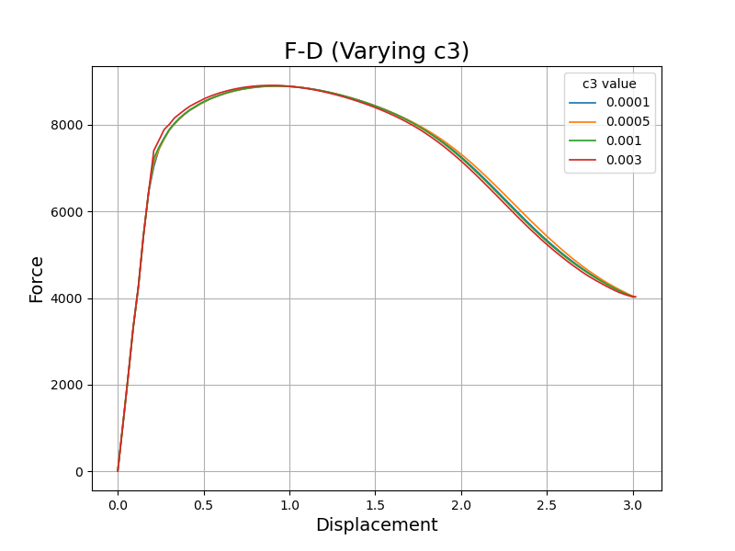
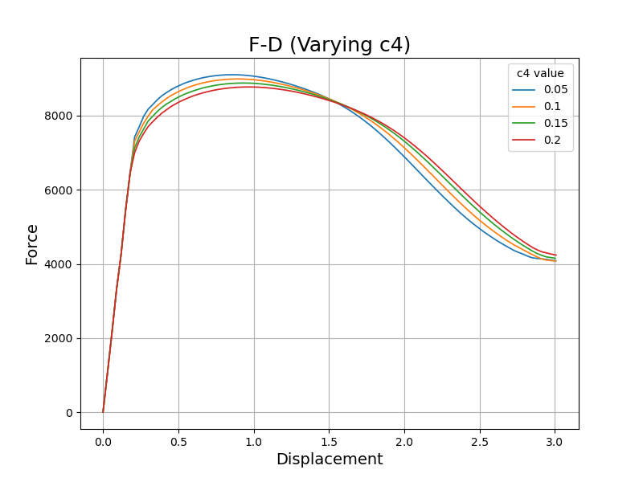
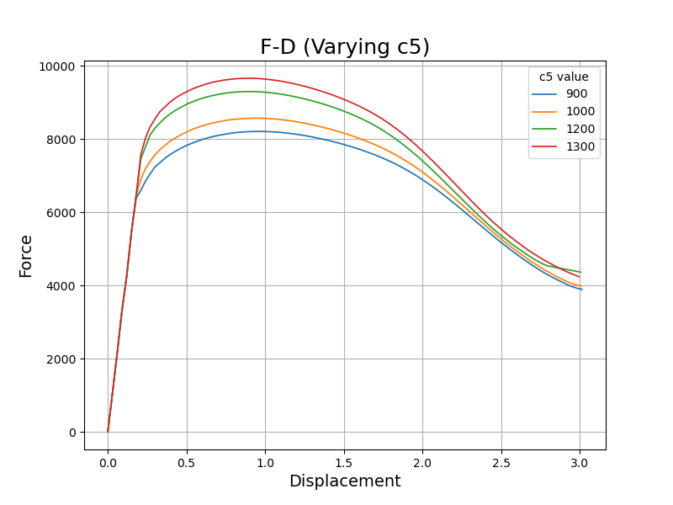
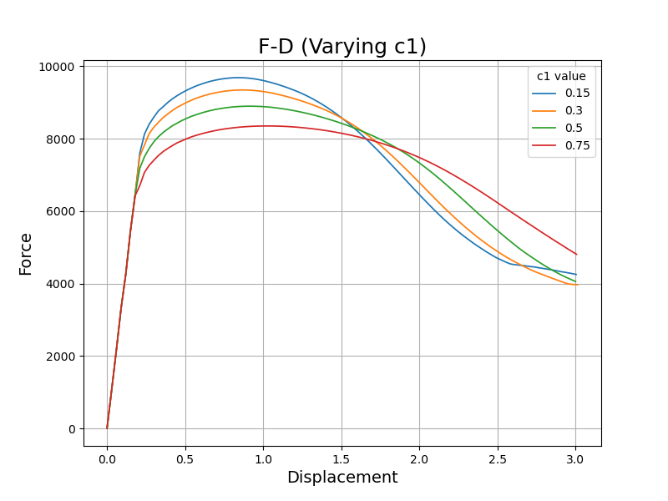
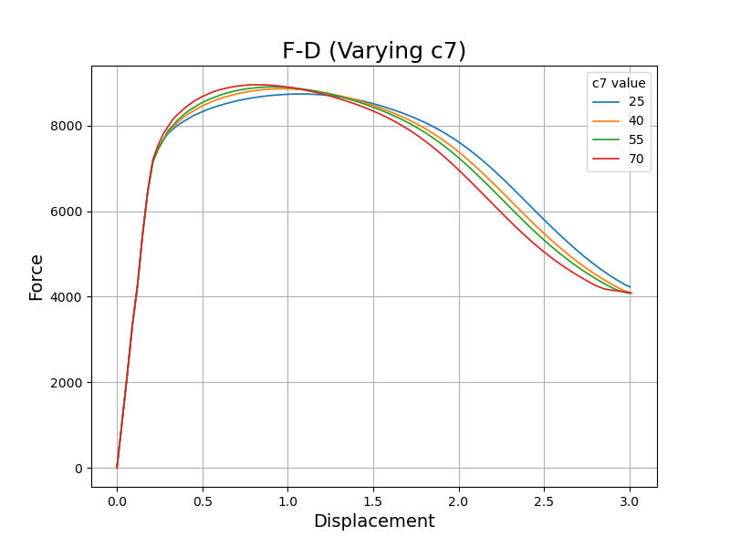
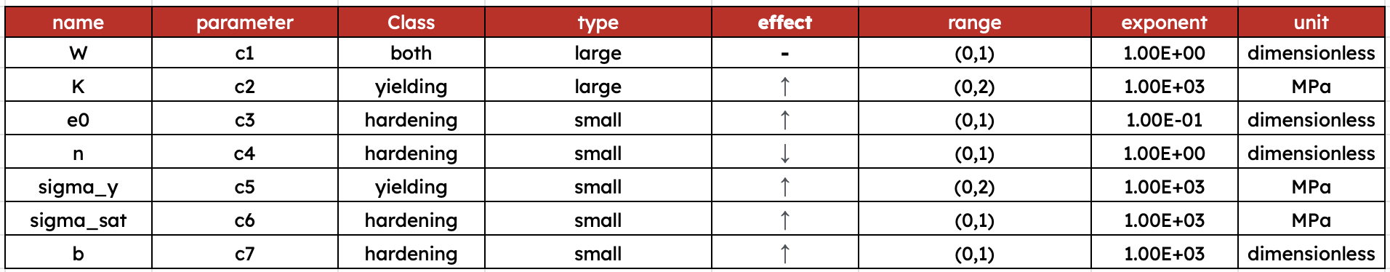
Parametric Study
Small Yielding
Large Yielding
Small Hardening
Large Hardening

Slide 9
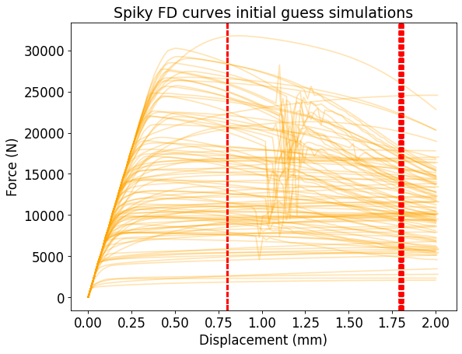
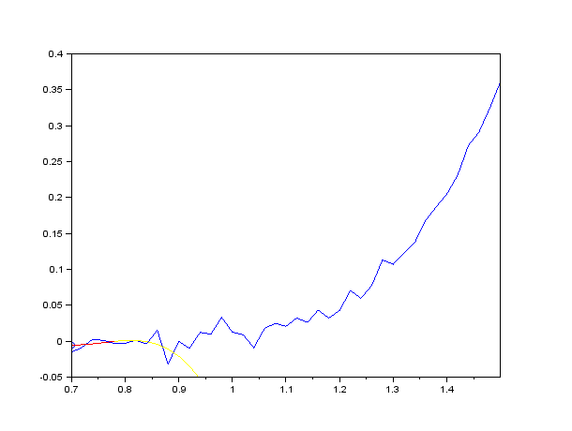
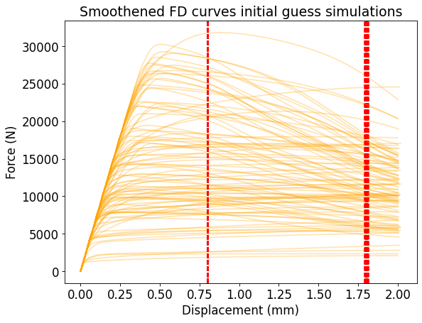
Savitzky–Golay filter for FD curves
Many reasons why FD curve simulations might not be smooth :
Coarse strain step size. Finer strain step size can smoothen the FD curve. This strategy worked for Swift law but did not show any improvements in the Swift Voce law
The time step in Abaqus Dynamic Explicit solver is too big.
Corresponding flow curve is extreme or unrealistic
Inherent simulation error in Abaqus solver?
Animation showing Savitzky-Golay smoothing being applied, passing through the data from left to right. The red line represents the local polynomial being used to fit a sub-set of the data. The smoothed values are shown as circles.

Slide 10
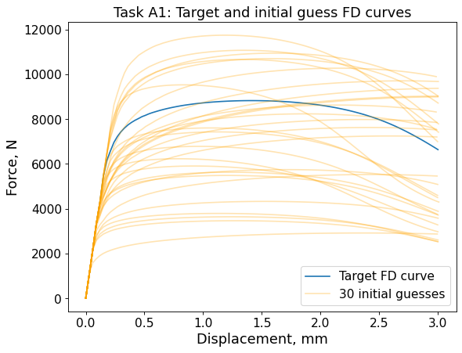
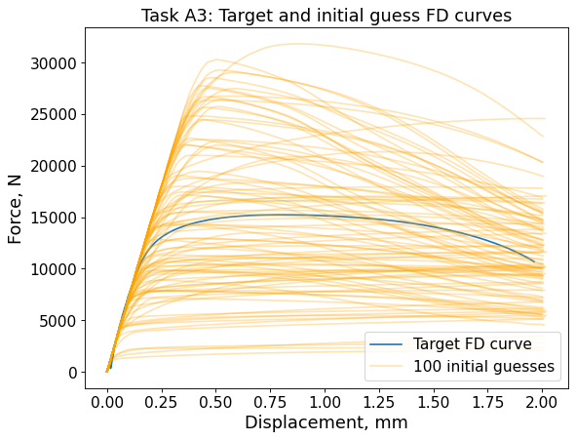
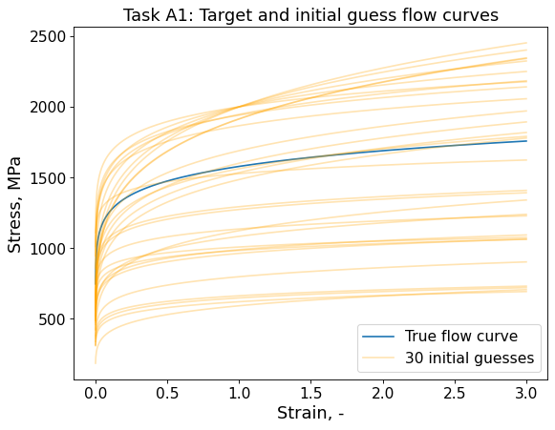
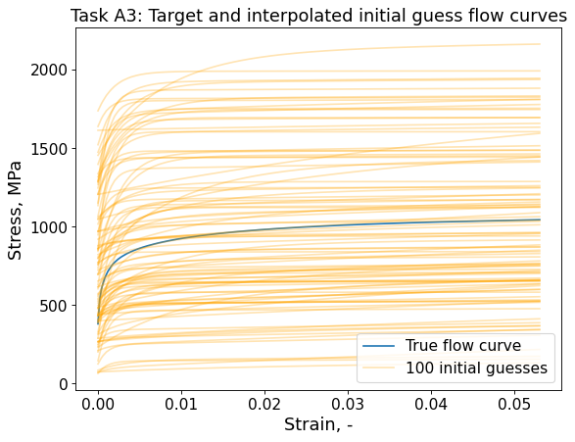
Initial guess force-displacement and flow curves
3 Parameters – Swift Law (30 Initial guesses)
7 Parameters – Swift-voce Law (100 Initial guesses)
Exploration vs Exploitation: They help balance exploring new areas and fine-tuning known promising regions, aiding in avoiding local minima.
Performance:
Well-chosen initial guesses can speed up convergence to the global optimum, saving computational resources.

Slide 11
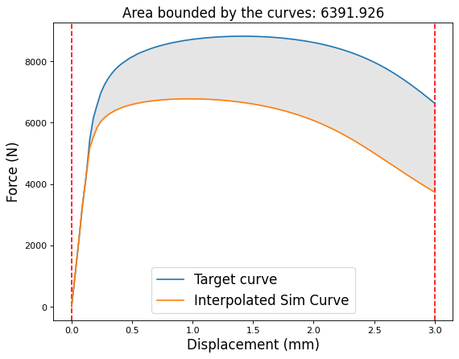
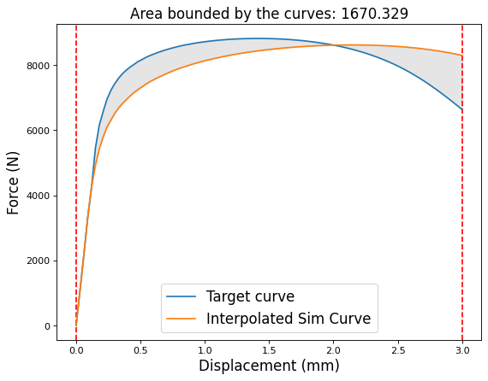
Loss function I (Binh’s definition)
The loss function is defined as the numerical area integration bounded by the two FD curves and two vertical y-axis at the minimum and maximum displacement value
The Intersect is defined as the list that includes all intersecting indices of two curves
If two curves do not intersect, then Intersect = [0, number of datapoints on FD curves]
If two curves intersect, then Intersect = [0, intersect_index1, …, intersect_indexN, number of datapoints on FD curves]

Slide 12
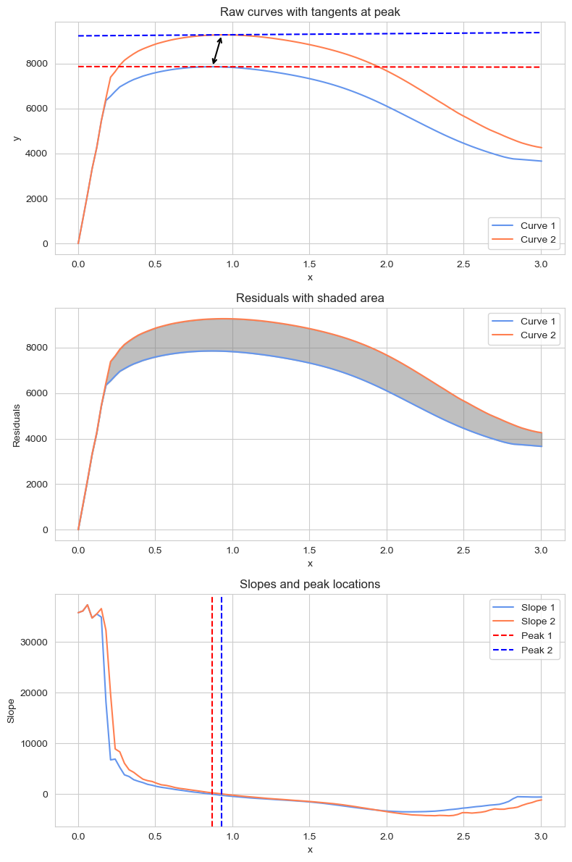
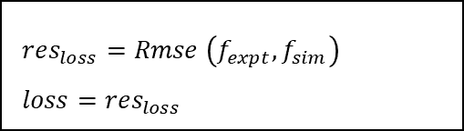
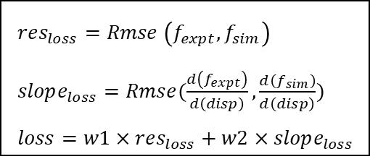
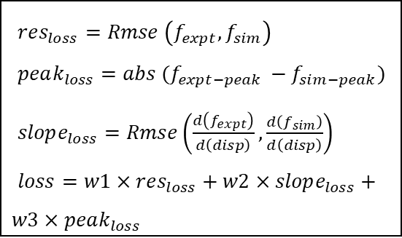
Loss Function II (Vedant’s Definition)
Linear Regression
Elastic Part
Plastic Part
1
Monotonic Curve
$res_{loss}=Rmse \left(f_{expt},f_{sim}\right)$
$loss=res_{loss}$
$res_{loss}=Rmse \left(f_{expt},f_{sim}\right)$
$slope_{loss}=Rmse(\frac{d\left(f_{expt}\right)}{d\left(disp\right)},\frac{d\left(f_{sim}\right)}{d\left(disp\right)})$
$loss=w1×res_{loss}+w2×slope_{loss}$
2
Non -Monotonic Curve (Peak)
The Loss Function is defined to take into consideration important regions and points on the force-displacement curve -
$res_{loss}=Rmse \left(f_{expt},f_{sim}\right)$
$peak_{loss}=abs (f_{expt−peak }−f_{sim−peak})$
$slope_{loss}=Rmse\left(\frac{d\left(f_{expt}\right)}{d\left(disp\right)},\frac{d\left(f_{sim}\right)}{d\left(disp\right)}\right)$
$loss=w1×res_{loss}+w2×slope_{loss}+w3×peak_{loss}$
Elastic Deformation Region
Plastic Deformation Region
Yielding Point
Ultimate Tensile Strength Point

Slide 13
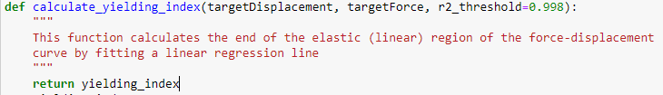
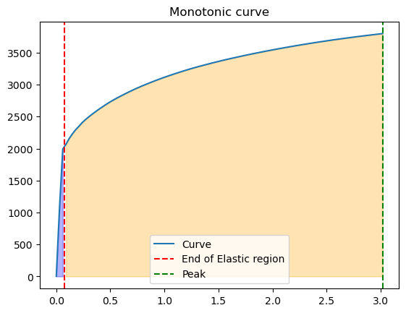
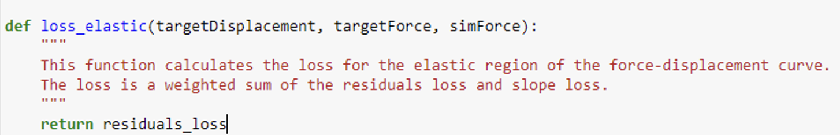
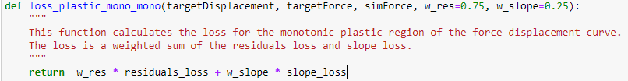
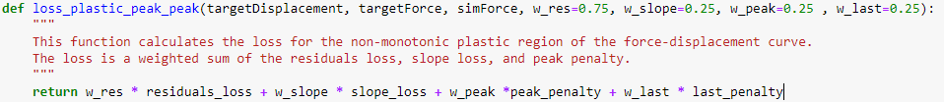
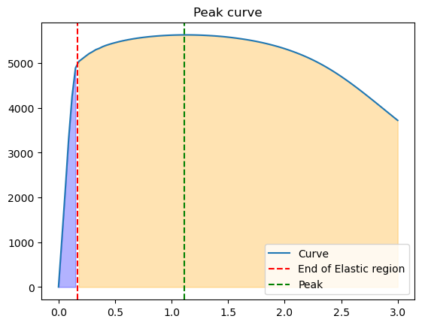
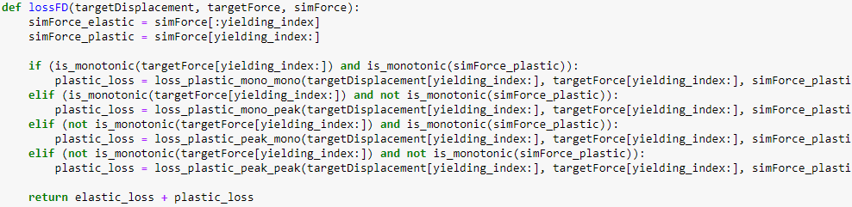
Loss Function II (Vedant’s Definition)
Pseudo-code
calculate_yielding_index(r2_threshold = 0.998)

Slide 14
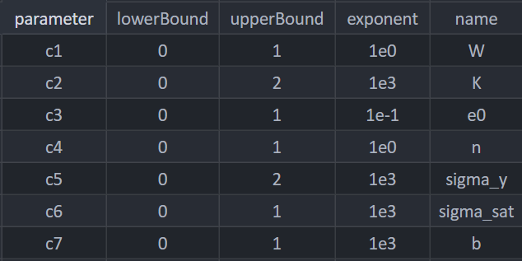
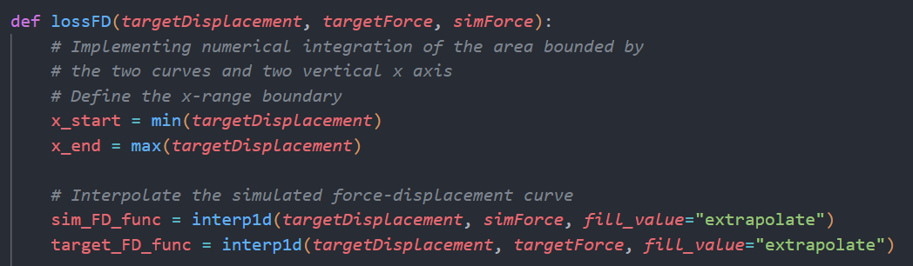
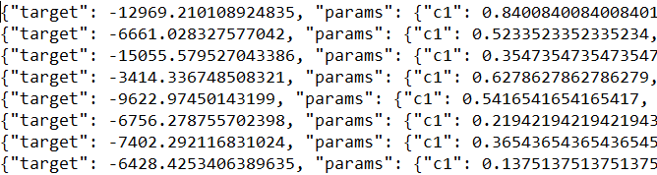
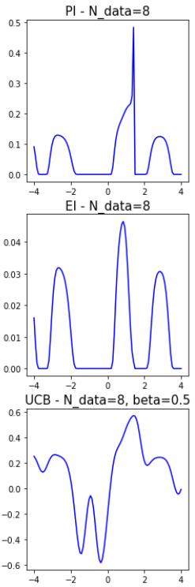
Bayesian Optimization configurations
Recap of how Bayesian optimization works:
Step 1: Define the parameter searching space
Step 2: Define the loss function (shown earlier) and writes the loss of initial guesses into a json log file
Step 3: Choose an acquisition function, which balances exploration (sampling new points in the search space) and exploitation (focusing on existing promising regions).
Acquisition functions can be Expected Improvement (EI), Probability of Improvement (PI), Upper Confidence Bound (UCB).
Notes:
Probability of Improvement (PI): This acquisition function chooses the point that has the highest probability of improving upon the current best observation. It tends to favour exploitation over exploration.
Expected Improvement (EI): Expected Improvement calculates the expectation of improvement at each point and selects the point with the maximum expected improvement. It balances exploration and exploitation better than PI does.
We have a big 7 dimensional search space and we m´know the nature of the curve, it doesn’t hava lot of local maximas to get stuck at, so POI is current used as acquisition fn as it tends to favour exploitation over exploration

Slide 15
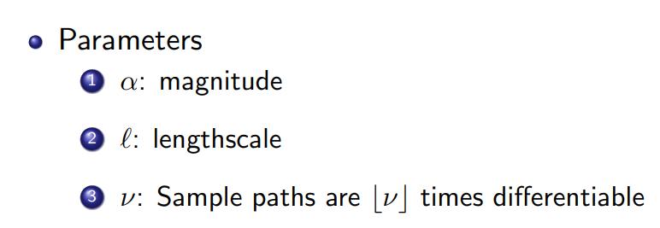
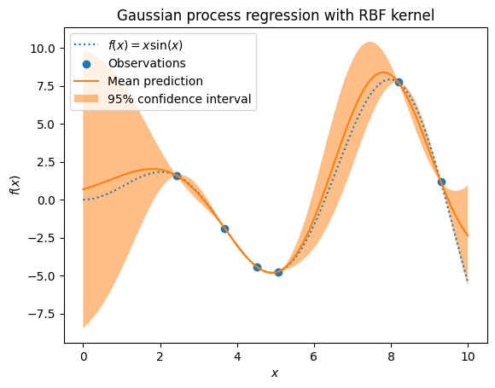
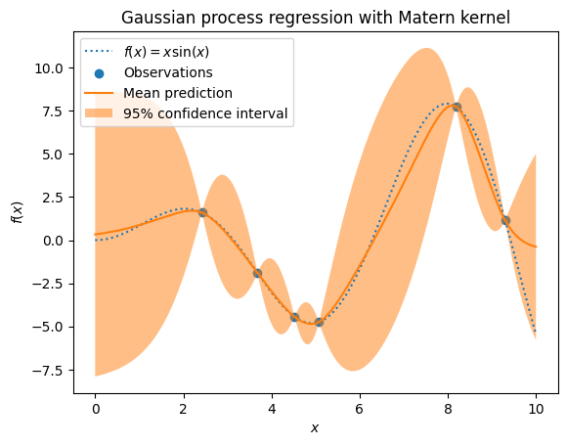
Bayesian Optimization configurations
Step 4: Initialize Gaussian Process (GP) regression model, that approximates the unknown objective function from the json log file. Two popular kernels (covariance matrix) used for Gaussian process are:
Radial Basis Function (RBF) kernel
Matérn kernel
Notes:
Radial Basis Function (RBF) Kernel: This is the most widely used kernel. The RBF kernel assumes that points closer in the input space will produce similar outputs. This assumption leads to smooth functions in the GP's model, which means that small changes in the input will produce small changes in the output. The RBF kernel is controlled by parameters that determine the scale of the fluctuations and how quickly the correlation between points drops off with distance.
Matérn Kernel: The Matérn kernel is a generalization of the RBF and allows more flexibility in the type of functions the GP can model. By adjusting the parameters of the Matérn kernel, we can control the smoothness of the resulting function. This means we can model functions that have sudden changes in the output for small changes in the input. It's beneficial when we believe the true function may have jumps or kinks.

Slide 16
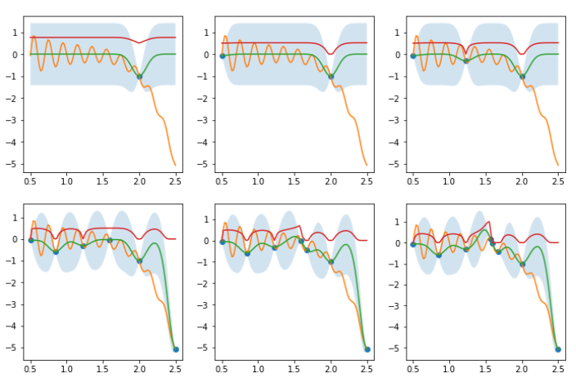
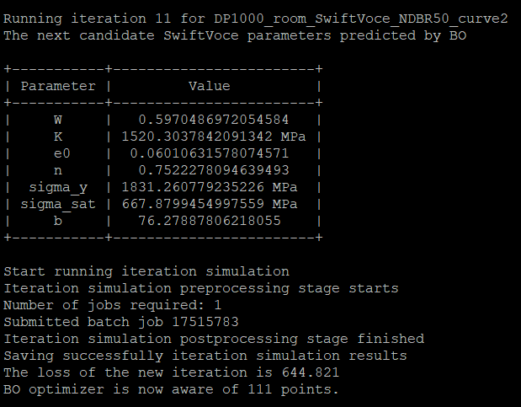
Bayesian Optimization configurations
Step 5: Select the next set of parameters to evaluate by optimizing the acquisition function based on the Gaussian processes. This involves balancing exploration and exploitation based on the Gaussian process surrogate model.
BayesOpt on finding maximum of Gramacy-Lee function with Probability of Improvement acquisition function + RBF kernel for GP (source: Binh)

Slide 17
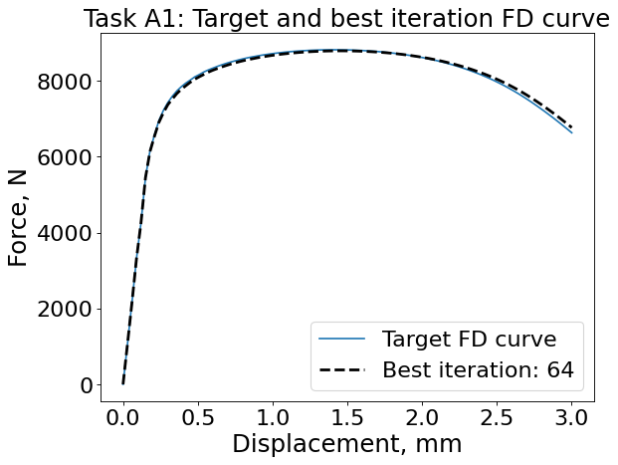
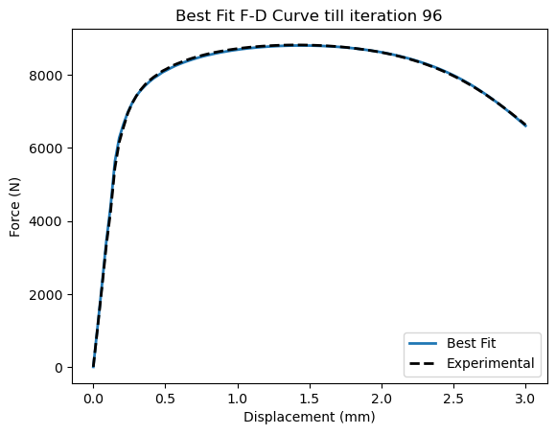
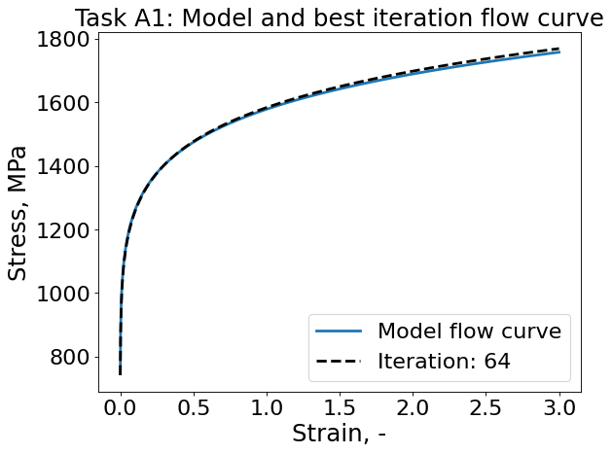
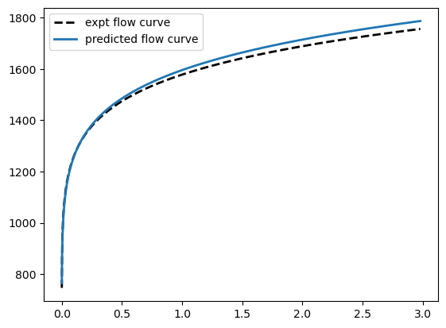
Parameter calibration results (Task A1), allowed deviation: 1%
loss function I
loss function II
Swift Law | True value | Predicted Value
K | 1578 | 1583.26
ε₀ | 0.000488 | 0.000541
n | 0.098 | 0.100
Swift Law | True value | Predicted Value
K | 1578 | 1595.67
ε₀ | 0.000488 | 0.000491
n | 0.098 | 0.103

Slide 18
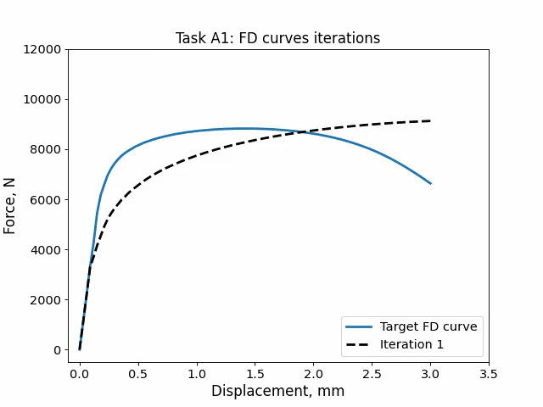
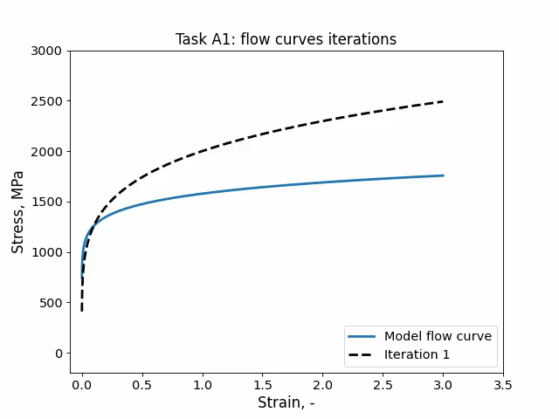




Iteration evolution (Task A1)
loss function
I
loss function
II

Slide 19




Parameter calibration results (Task A2), allowed deviation: 2%
Loss function I
Loss function II
Swift Voce Law | Predicted Value
W | 0.5
K | 1638.50
ε₀ | 0.03278
n | 0.48248
σᵧ | 1030.52
σₛₐₜ | 847.63
β | 300.184
Swift Voce Law | Predicted Value
W | 0.63
K | 1444.69
ε₀ | 0.0458
n | 0.4902
σᵧ | 1684.718
σₛₐₜ | 804.323
β | 213.224

Slide 20




Parameter calibration results (Task A3)
Loss function I
Loss function II
Swift Voce Law | Predicted Value
W | 0.5
K | 1784.06
ε₀ | 0.093278
n | 0.09623
σᵧ | 0
σₛₐₜ | 614.555
β | 98.285
Swift Voce Law | Predicted Value
W | 0.5
K | 1246.55
ε₀ | 0.001431
n | 0.05469
σᵧ | 481.11
σₛₐₜ | 575.803
β | 134.72

Slide 21




Parameter calibration results (Task A4)
Loss function I
Loss function II
Swift Voce Law | Predicted Value
W | 0.5
K | 1206.708
ε₀ | 0.04282
n | 0.2083
σᵧ | 518.2936
σₛₐₜ | 635.406
β | 415.513
Swift Voce Law | Predicted Value
W | 0.5
K | 1393.868
ε₀ | 0.08035
n | 0.1199
σᵧ | 208.37
σₛₐₜ | 605.08
β | 109.25

Slide 22


Conclusion
Swift Voce law is considerably much more difficult to measure or calibrate than the Swift law
The fraction parameter W in Swift Voce law is challenging to calibrate due to unknown distributions of Swift and Voce laws on the plastic region of FD curve. Swift Voce law took much more iterations than Swift law
A good strategy is to fix the parameter W as 0.5 for Swift Voce law, which is in line with existing literatures
Nearly similar flow curves can produce noticeably different force-displacement curves

Slide 23




Conclusion
The flow curve to force displacement curve mapping is not one-one function, as even on exactly matching the force displacement, there is no guarantee that the flow curve will match
Comparing the two different loss functions on a common scale(Sum of Absolute errors)

Slide 24
Acknowledgments:
Thank you to everyone for listening to me, and to Prof. Lian and my advisors for their constant support and guidance

